Slide 1

Warby Parker
Funnels Usage – SQL and Excel Project
Fırat Olçum
28-07-2022

Slide 2
Table of Contents
What is Warby Parker
Quiz Funnel
Home Try-On Funnel
Actionable Insights

Slide 3
1. What is Warby Parker

Slide 4
Warby Parker is a socially conscious company that operates with the objective to offer designer eyewear at a revolutionary price.
When costumers interact with Warby’s website, they are first encouraged to fill out a quiz to help them narrow down the options.After completing the survey, they can select a set number of glasses to try at home before deciding whether they want to make a purchase.
We will explore the data collected along the customer journey to retrieve insight that addresses the company’s objective.

Slide 5
2. Quiz Funnel

Slide 6
2.1 Columns on the Survey table
question | user_id | response
1. What are you looking for? | 005e7f99-d48c-4fce-b605-10506c85aaf7 | Women's Styles
2. What's your fit? | 005e7f99-d48c-4fce-b605-10506c85aaf7 | Medium
3. Which shapes do you like? | 00a556ed-f13e-4c67-8704-27e3573684cd | Round
4. Which colors do you like? | 00a556ed-f13e-4c67-8704-27e3573684cd | Two-Tone
1. What are you looking for? | 00a556ed-f13e-4c67-8704-27e3573684cd | I'm not sure. Let's skip it.
2. What's your fit? | 00a556ed-f13e-4c67-8704-27e3573684cd | Narrow
5. When was your last eye exam? | 00a556ed-f13e-4c67-8704-27e3573684cd | <1 Year
3. Which shapes do you like? | 00bf9d63-0999-43a3-9e5b-9c372e6890d2 | Square
5. When was your last eye exam? | 00bf9d63-0999-43a3-9e5b-9c372e6890d2 | <1 Year
2. What's your fit? | 00bf9d63-0999-43a3-9e5b-9c372e6890d2 | Medium
The Survey table consist of the three columns: question, user_id and response.
The quiz column consists of the following questions:
What are you looking for?
What’s your fit?
Which shapes do you like?
Which colors do you like?
When was your last eye exam?
As you can see from the table on the right, for every question answered we know the user id and their response.

Slide 7
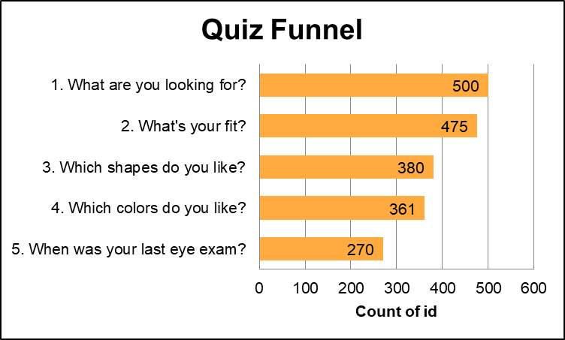
2.2 Number of responses for each question
--SQL Code
SELECT
question,
COUNT(DISTINCT user_id) AS number_of_responses
FROM survey
GROUP BY question;
Using GROUP BY statement we organize the data to COUNT the number of users that answered each question. The code on the right produces the numbers in the chart on the left. As you can see from the chart, the number of respondents is decreasing for each question.

Slide 8
2.3 Question of the quiz with a lower completion rate
question | NumberOfResponses | PriorNumberOfResponses | PercentCompleteThisQuestion
1. What are you looking for? | 500
2. What's your fit? | 475 | 500 | 95.0
3. Which shapes do you like? | 380 | 475 | 80.0
4. Which colors do you like? | 361 | 380 | 95.0
5. When was your last eye exam? | 270 | 361 | 75.0
--SQL Code
WITH temp_table AS
(
SELECT DISTINCT question,
COUNT( user_id) OVER(PARTITION BY question) NumberOfResponses
FROM survey
),
temp_table2 AS
(
SELECT *, LAG(NumberOfResponses) OVER() PriorNumberOfResponses
FROM temp_table
)
SELECT *, ROUND((100.0 * NumberOfResponses / PriorNumberOfResponses), 0) AS PercentCompleteThisQuestion
FROM temp_table2
Looking at the table on left, we can see that questions 1, 2 and 4 had the highest answer rate, followed by question 3 and 5 with the lowest ones.

Slide 9
2.4 Possible reasons behind lower completion rates
It is interesting to note that each question has a neutral or skip option as an answer, which means that users can always move on to the next question without making a concrete choice as opposed to not completing the quiz all together.
Even given the option to skip, almost half the users still decided to discontinue the quiz on questions 3 and 5, which directs us to having a closer look at the questions.
Despite also being a question about the user’s preference, question 3 ‘Which shapes do you like’ has a far larger response rate drop than question 4 ‘Which colors do you like?’.
This might be because we are more likely to already have a favorite color that we would choose as our answer. Whereas the shape of glasses is more complex and usually requires previous try on sessions in order to know one’s preference. A first time purchaser would not have such exposure for example.
Like question 2 ’What’s your fit?’, question 5 ‘When was your last eye exam?’ is measurable and objective. However, the latter has a far larger response rate drop. Is the issue also within the question itself? Or could we attribute it to the fact that it’s the final question of the quiz funnel, and therefore that a large drop would be expected?

Slide 10
3. Home Try-On Funnel

Slide 11
3.1 Looking at the data (limit to 3 rows)
quiz table
user_id | style | fit | shape | color
4e8118dc-bb3d-49bf-85fc-cca8d83232ac | Women's Styles | Medium | Rectangular | Tortoise
291f1cca-e507-48be-b063-002b14906468 | Women's Styles | Narrow | Round | Black
75122300-0736-4087-b6d8-c0c5373a1a04 | Women's Styles | Wide | Rectangular | Two-Tone
home_try_on table
user_id | number_of_pairs | address
d8addd87-3217-4429-9a01-d56d68111da7 | 5 pairs | 145 New York 9a
f52b07c8-abe4-4f4a-9d39-ba9fc9a184cc | 5 pairs | 383 Madison Ave
8ba0d2d5-1a31-403e-9fa5-79540f8477f9 | 5 pairs | 287 Pell St
purchase table
user_id | product_id | style | model_name | color | price
00a9dd17-36c8-430c-9d76-df49d4197dcf | 8 | Women's Styles | Lucy | Jet Black | 150
00e15fe0-c86f-4818-9c63-3422211baa97 | 7 | Women's Styles | Lucy | Elderflower Crystal | 150
017506f7-aba1-4b9d-8b7b-f4426e71b8ca | 4 | Men's Styles | Dawes | Jet Black | 150

Slide 12
3.1 home_try_on_funnel table
user_id | is_home_try_on | number_of_pairs | is_purchase
4e8118dc-bb3d-49bf-85fc-cca8d83232ac | True | 3 pairs | False
291f1cca-e507-48be-b063-002b14906468 | True | 3 pairs | True
75122300-0736-4087-b6d8-c0c5373a1a04 | False | N/A | False
75bc6ebd-40cd-4e1d-a301-27ddd93b12e2 | True | 5 pairs | False
ce965c4d-7a2b-4db6-9847-601747fa7812 | True | 3 pairs | True
28867d12-27a6-4e6a-a5fb-8bb5440117ae | True | 5 pairs | True
5a7a7e13-fbcf-46e4-9093-79799649d6c5 | False | N/A | False
--SQL Code
WITH home_try_on_funnel AS
(
SELECT DISTINCT q.user_id,
CASE WHEN h.user_id IS NOT NULL THEN 'True' ELSE 'False' END AS is_home_try_on,
CASE WHEN h.number_of_pairs IS NULL THEN 'N/A' ELSE h.number_of_pairs END AS number_of_pairs,
CASE WHEN p.user_id IS NOT NULL THEN 'True' ELSE 'False' END AS is_purchase
FROM quiz q
LEFT JOIN home_try_on h
ON q.user_id = h.user_id
LEFT JOIN purchase p
ON q.user_id = p.user_id
)
SELECT *
FROM home_try_on_funnel
LIMIT 7;
Using a WITH clause and two LEFT JOINs we can combine all three tables into one.This table includes the id of all the users who completed the quiz, as well as whether they tried-on glasses at home, received 3, 5 or no pairs, and made a purchase.

Slide 13
4. Actionable Insights

Slide 14
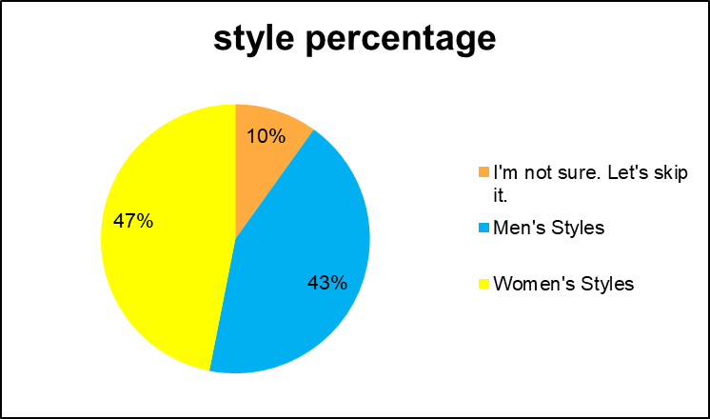
4.1.1 quiz table style column
--SQL Code
WITH temp_table AS
(
SELECT DISTINCT style,
COUNT(user_id) OVER(PARTITION BY style) AS style_counts
FROM quiz
ORDER BY style_counts DESC
)
SELECT style,
100.0 * style_counts /SUM(style_counts) OVER() AS style_percentage
FROM temp_Table
You can see the style preferences of the participants participating in the quiz as a percentage. While 47% of the participants chose woman styles, 43% chose men styles. and 10% are undecided. The 'unisex' option can be included in the quiz as a suitable style for this 10%.

Slide 15
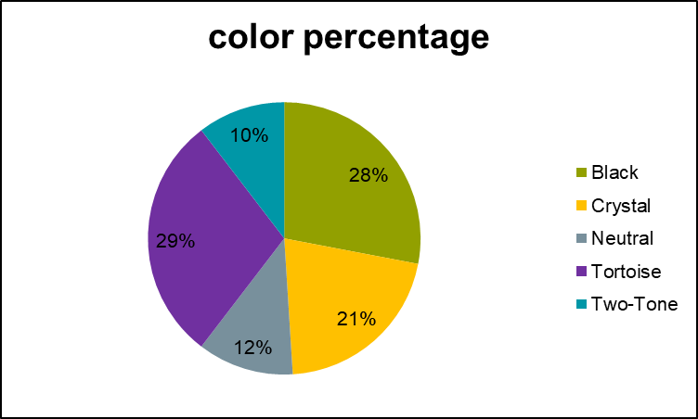
4.1.2 quiz table style column
--SQL Code
WITH temp_table AS
(
SELECT DISTINCT color,
COUNT(user_id) OVER(PARTITION BY color) AS color_counts
FROM quiz
ORDER BY color_counts DESC
)
SELECT color,
100.0 * color_counts /SUM(color_counts) OVER() color_percentage
FROM temp_table
You can see the color preferences of the participants participating in the quiz as a percentage. We see that the most preferred colors are tortoise and black.

Slide 16
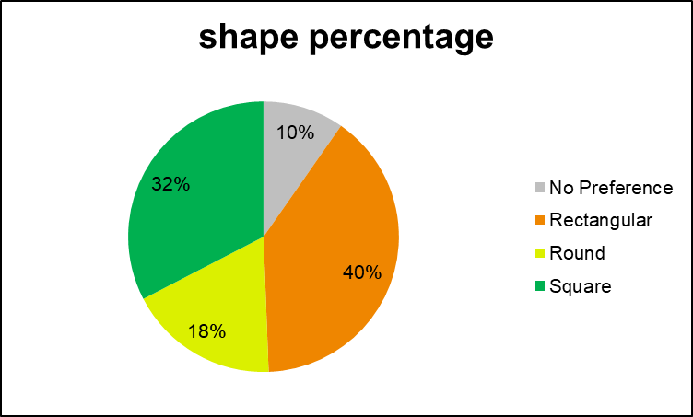
4.1.3 quiz table shape column
--SQL Code
WITH temp_table AS
(
SELECT DISTINCT shape,
COUNT(user_id) OVER(PARTITION BY shape) AS shape_counts
FROM quiz
ORDER BY shape_counts DESC
)
SELECT shape,
100.0 * shape_counts /SUM(shape_counts) OVER() shape_percentage
FROM temp_table
You can see the shape preferences of the participants participating in the quiz as a percentage. We see that the most preferred shapes are rectangular and square. 10% of the participants did not make any choice. Other option can be put here.

Slide 17
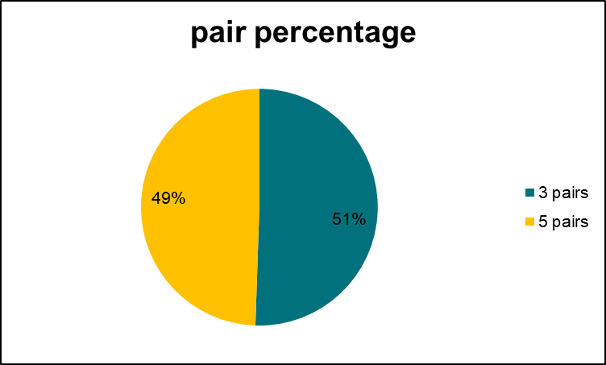
4.2.1 home_try_on table number_of_pairs column
--SQL Code
WITH temp_table AS
(
SELECT number_of_pairs,
COUNT(DISTINCT user_id) pair_counts
FROM home_try_on
GROUP BY number_of_pairs
)
SELECT number_of_pairs,
100.0 * pair_counts / SUM(pair_counts) OVER() AS pair_percentage
FROM temp_table
You can see the shape preferences of the participants participating in the home_try_on as a percentage. There is no distinguishing difference between the participants who tried 3 pairs and 5 pairs of glasses at home. It is not possible to draw an insight from this chart.

Slide 18
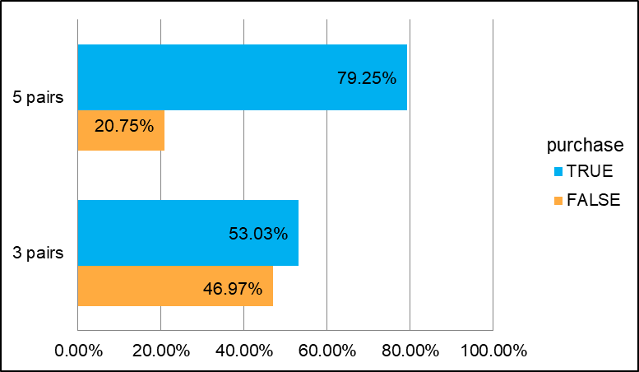
4.2.2 home_try_on table purchase insight
--SQL Code
WITH home_try_on_funnel AS
(
SELECT DISTINCT q.user_id, h.number_of_pairs,
CASE WHEN p.user_id IS NOT NULL THEN 'True' ELSE 'False' END AS is_purchase
FROM quiz q
LEFT JOIN home_try_on h
ON q.user_id = h.user_id
LEFT JOIN purchase p
ON q.user_id = p.user_id
)
SELECT number_of_pairs, is_purchase, COUNT(is_purchase) AS TotalCountOfPurchase
FROM home_try_on_funnel
GROUP BY number_of_pairs, is_purchase
HAVING number_of_pairs IS NOT NULL;
You can see the purchase rates of the products tried as 3 pairs and 5 pairs. 26% more of the users that received 5 pairs of glasses completed a purchase compared to the users that only received 3 pairs.

Slide 19
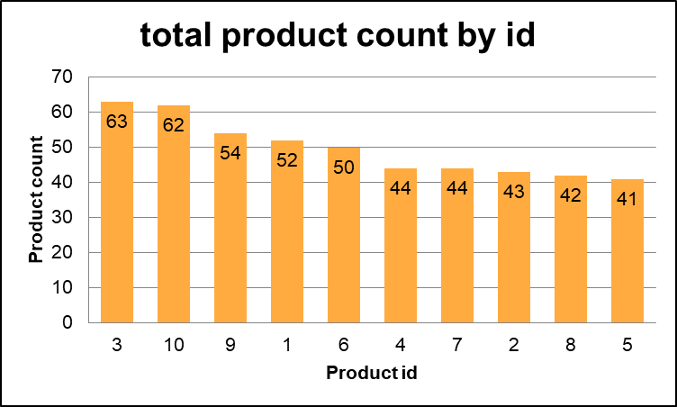
4.3.1 purchase table product_id column
--SQL Code
SELECT product_id,
COUNT(DISTINCT user_id ) AS product_count
FROM purchase
GROUP BY product_id
ORDER BY product_id
You can see the product preferences of the participants participating in the purchase as a count. Products with 3 and 10 prdouct ids were sold more than others.

Slide 20
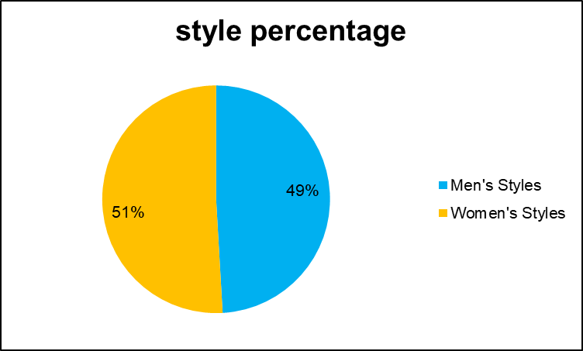
4.3.2 purchase table style column
--SQL Code
SELECT style,
COUNT(DISTINCT user_id) AS style_count
FROM purchase
GROUP BY style
You can see the style preferences of the participants participating in the purchase as a percentage. While 51% of the customers preferred women's styles, 49% preferred men's styles. We can say that there is an equal distribution in terms of gender.

Slide 21
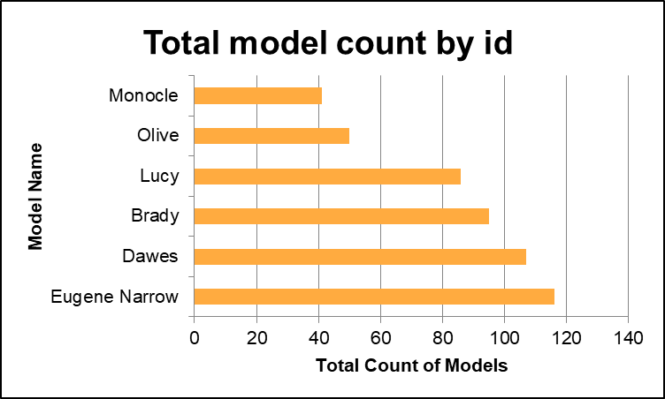
4.3.3 purchase table model_name column
--SQL Code
SELECT model_name,
COUNT(DISTINCT user_id) AS model_count
FROM purchase
GROUP BY model_name
You can see the model preferences of the participants participating in the purchase as a count. We see that the most preferred models by customers are ‘Eugine Narrow’ and ‘Dawes’ models. The least preferred are ‘Monocle’ and ‘Olive’. Discounts on these two models can increase their sales.

Slide 22
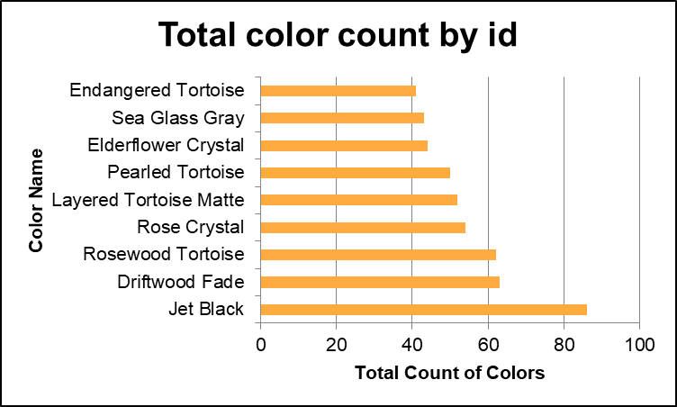
4.3.4 purchase table color column
--SQL Code
SELECT color,
COUNT(DISTINCT user_id) AS color_count
FROM purchase
GROUP BY color
You can see the color preferences of the participants participating in the purchase as a count. We see that the most preferred color by customers is ‘Jet Black’. If you produce other models similar to this model, we can assume that they will sell well.

Slide 23
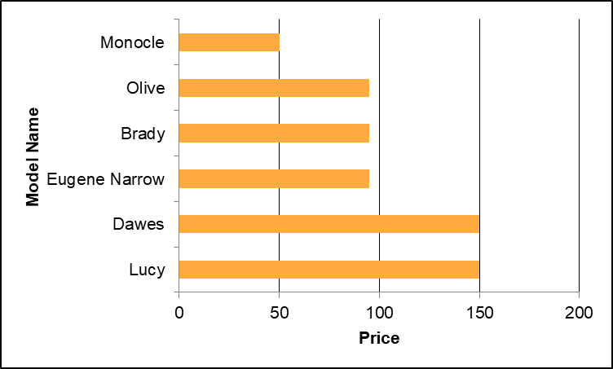
4.3.5 purchase table price column
--SQL Code
SELECT DISTINCT(model_name), price
FROM purchase
ORDER BY price DESC
You can see the prices according to the names of the models. The two most expensive models are the ‘Dawes’ and ‘Lucy’.

Slide 24
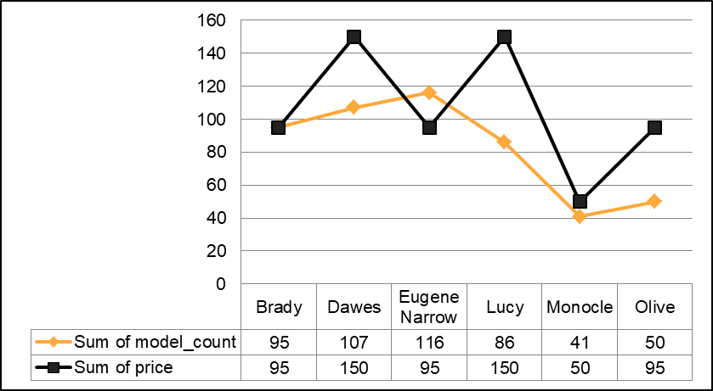
4.3.6 purchase table price column
--SQL Code
SELECT DISTINCT(model_name),
COUNT(user_id) AS model_count, price
FROM purchase
GROUP BY model_name
ORDER BY price DESC, model_count DESC
You can see the Dawes model being the best selling model despite being the most expensive model. Customers who bought this model did not pay much attention to the price. The price of this product can be increased. In addition, although the monocle model is the cheapest model, it is the least sold model. The design of this model can be changed.

Slide 25
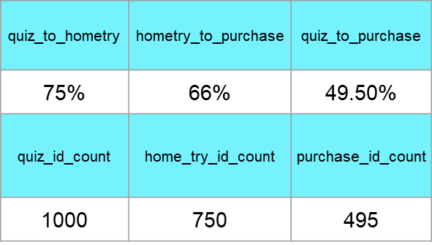
4.3.7 funnel insights
--SQL Code
WITH T1 AS(
SELECT COUNT(DISTINCT q.user_id) AS quiz_id_count,
COUNT(DISTINCT h.user_id) AS home_try_id_count ,
COUNT(DISTINCT p.user_id) AS purchase_id_count
FROM quiz q
LEFT JOIN home_try_on h
ON q.user_id = h.user_id
LEFT JOIN purchase p
ON q.user_id = p.user_id
)
SELECT
quiz_id_count, home_try_id_count, purchase_id_count,
(100.0 * home_try_id_count / quiz_id_count) AS quiz_to_hometry,
(100.0 * purchase_id_count / home_try_id_count) AS hometry_to_purchase,
(100.0 * purchase_id_count / quiz_id_count) AS quiz_to_purchase
FROM T1
Almost half the users that completed the quiz made a purchase. We see that we loose 25% of users on the second stage and then even more on the third stage with 34%. We know that to retain more people from hometry to purchase, WarbyParker should offer users 5 pairs to try-on at home as it has proven to be more successful. Creating an A/B test during the quiz stage, could help determine how to drive more costumers to the try-on stage.

Slide 26
Thank you for your time and attention.

